Slide 1

Prospects for Growth and Change:
U.S. Metro Area Forecast 2022-2032
For REMI User's Conference 2022
Frederick Treyz, Ph.D.
CEO, Chief Economist

Slide 2
Agenda
National Economic Context
Regional Demographics and Economics
Economic Modeling as a Framework
Policy Challenges

Slide 3
Introduction
REMI is a national and regional economic forecasting and policy analysis model
Our baseline forecasts are developed using a well-defined and transparent methodology, based on REMI structural economic and demographic equations, and national macroeconomic projections primarily from the U.S. Bureau of Economic Analysis and the Congressional Budget Office
The forecast can be adjusted to reflect local expertise, such as: land use constraints, planned economic development (e.g. a new factory); potential scenarios such as a recession; or the effect of policy changes.
We present the default forecast for a transparent methodology that incorporates assumptions from authoritative sources, in particular the BEA and CBO.

Slide 4
National Economic Context
REMI is a Top-Down/Bottom-Up Methodology
BLS: I-O Tables projected-2031, Employment by Industry Projection-2031, Labor Force Participation Rates through 2031
Census: Fertility rates, survival rates, international migration
RSQE (short-term): GDP, Personal Income, Employment
Long-term forecast: Congressional Budget Office (CBO)
Notes:
Lockout slide

Slide 5
Table 1: US Economic Forecast Summary 2022-32
Category | Units | 2022 | 2032 | 2022-2032 % Change
Total Employment | Thousands (Jobs) | 205,289 | 212,296 | 3%
Population | Thousands | 332,960 | 350,338 | 5%
Labor Force | Thousands | 164,280 | 174,421 | 6%
Gross Domestic Product | Billions of Fixed (2012) Dollars | $25,110 | $29,553 | 18%

Slide 6
Table 2: US Employment Forecast by Industry 2022-32
Industry | 2022* | 2032* | 2022-2032 Change (Difference in Employment)* | 2022-2032 Change (%)
All Industries | 205,289 | 212,296 | 7,007 | 3.4%
Forestry, fishing, and hunting | 1,024 | 1,073 | 49 | 4.8%
Mining | 966 | 998 | 31 | 3.3%
Utilities | 605 | 545 | -61 | -10.0%
Construction | 10,951 | 11,353 | 401 | 3.7%
Manufacturing | 14,514 | 14,637 | 123 | 0.8%
Wholesale trade | 6,624 | 6,442 | -182 | -2.7%
Retail trade | 18,968 | 17,114 | -1,853 | -9.8%
Transportation and warehousing | 10,066 | 10,551 | 485 | 4.8%
Information | 3,495 | 3,404 | -91 | -2.6%
Finance and insurance | 10,985 | 10,779 | -206 | -1.9%
Real estate and rental and leasing | 9,418 | 9,689 | 271 | 2.9%
Professional, scientific, and technical services | 15,569 | 16,859 | 1,290 | 8.3%
Management of companies and enterprises | 2,917 | 2,825 | -92 | -3.2%
Administrative, support, waste management, and remediation services | 12,682 | 13,403 | 721 | 5.7%
Educational services; private | 4,911 | 5,299 | 388 | 7.9%
Health care and social assistance | 23,731 | 26,124 | 2,393 | 10.1%
Arts, entertainment, and recreation | 4,340 | 5,261 | 921 | 21.2%
Accommodation and food services | 14,533 | 15,380 | 847 | 5.8%
Other services (except public administration) | 11,445 | 12,185 | 740 | 6.5%
State and Local Government | 19,799 | 20,619 | 820 | 4.1%
Federal Civilian | 3,073 | 3,133 | 60 | 2.0%
Federal Military | 1,854 | 1,874 | 20 | 1.1%
Farm | 2,820 | 2,750 | -70 | -2.5%
Notes:
Lockout slide

Slide 7
Agenda
National Economic Context
Regional Demographics and Economics
Economic Modeling as a Framework
Policy Challenges

Slide 8
Regional Demographics and Economics
Demographics:
Age structure
Amenities/quality of life
International migration
Cost of living
Employment:
Growing, productive industries;
Strong industry clusters
Notes:
Lockout slide

Slide 9
Figure 1: Metropolitan Population Forecast (2022-2032 % Change)
Notes:
Lockout slide

Slide 10
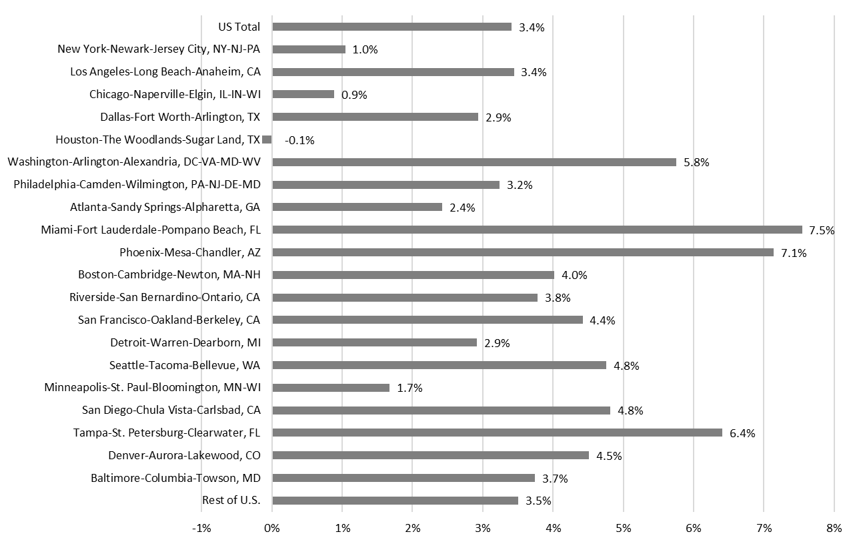
Figure 2: Metropolitan Employment Forecast (2022-2032 % Change)

Slide 11
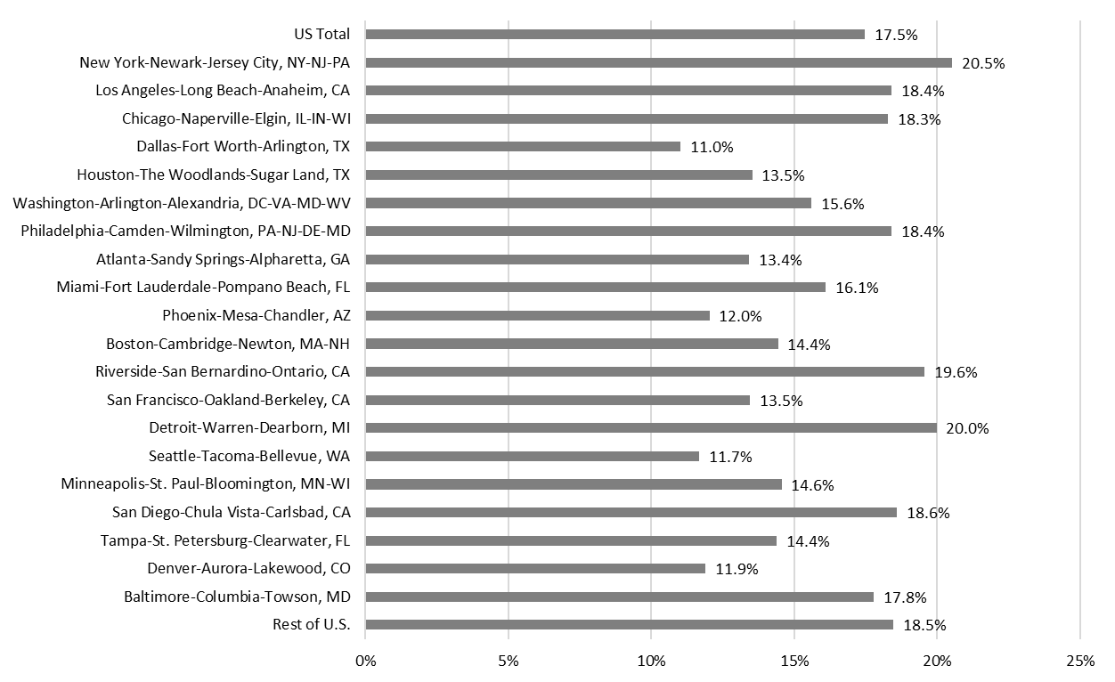
Figure 3: Metropolitan Real Disposable Income per Capita Forecast (2022-2032 % Change)

Slide 12
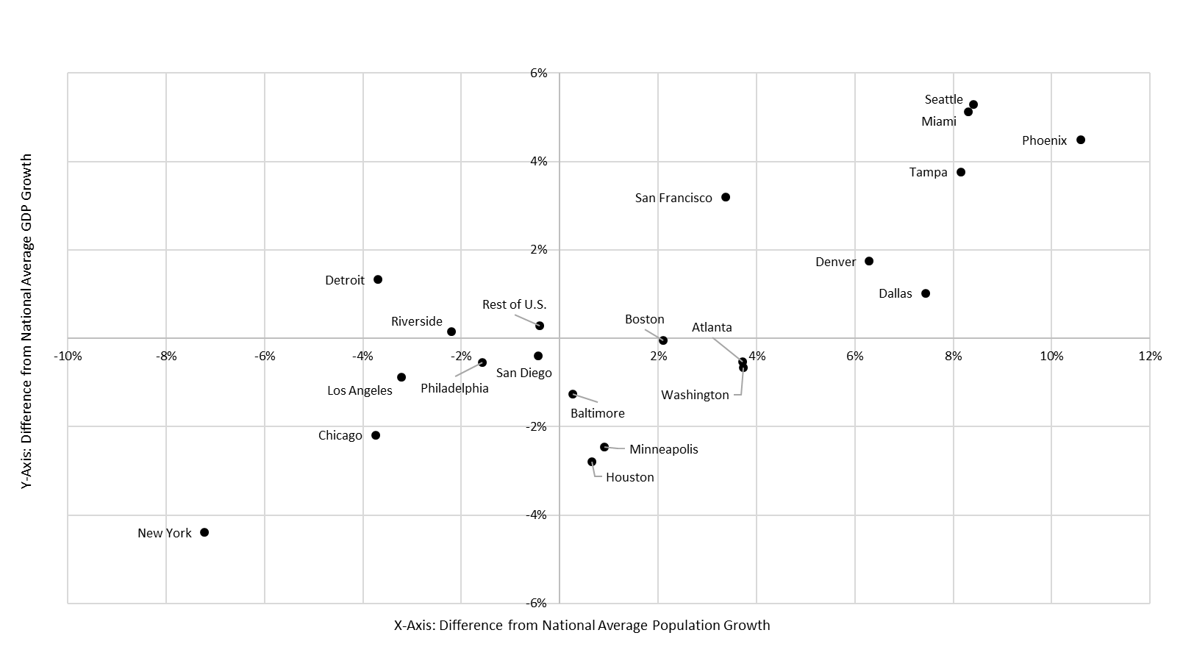
Figure 4: Metropolitan Growth Matrix: GDP vs. Population Growth (2022-2023)
Category 3

Slide 13
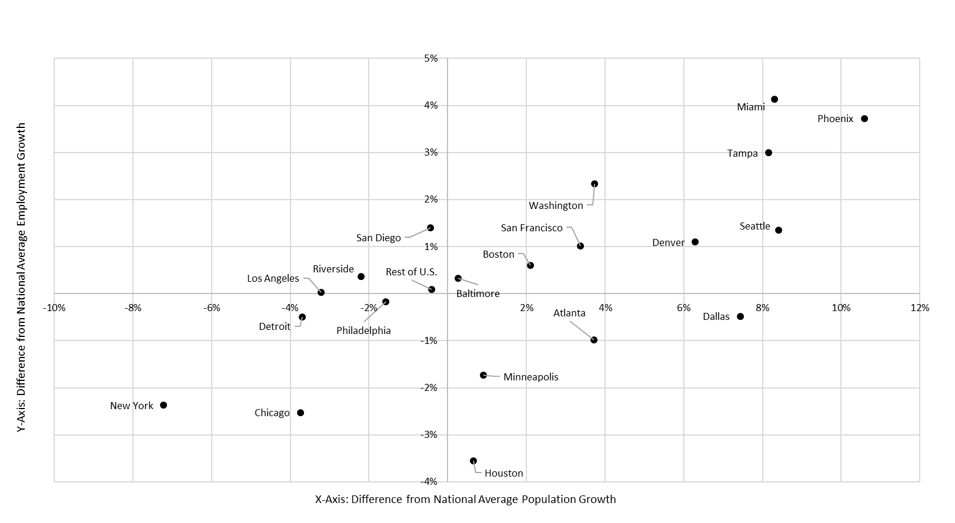
Figure 5: Metropolitan Growth Matrix: Employment vs. Population Growth (2022-2023)
Category 3

Slide 14
Agenda
National Economic Context
Regional Demographics and Economics
Economic Modeling as a Framework
Policy Challenges

Slide 15
Economic Modeling as a Framework
National Forecast Assumptions
Productivity: increases GDP, but fewer workers needed
Demographics: Immigration, birth rates, labor force participation
Regional
Housing Price and Land-Use Constraint Assumptions
Amenities and Quality of Life
Urban Hierarchy
Future of Work
Notes:
Lockout slide

Slide 16
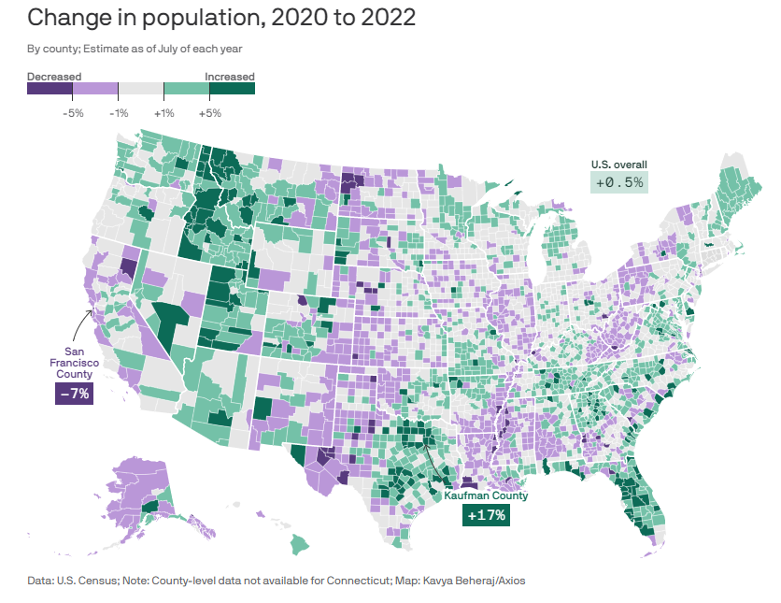
Economic Modeling as a Framework (source: Axios)

Slide 17
Agenda
National Economic Context
Regional Demographics and Economics
Economic Modeling as a Framework
Policy Challenges

Slide 18
Policy Challenges
Political Economic Context
Aging and slowing population growth
U.S. debt at 120% of GDP; difficult to sustain
Zero sum game and populism
Government spending 36% of GDP
Economic growth 1.8% depends on public and private sector
Notes:
Lockout slide

Slide 19
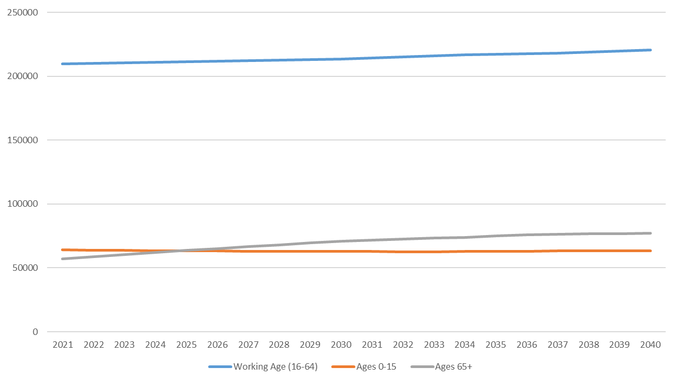
Figure 6: Population by Working Age and Other Cohorts (US Total)
Category 3

Slide 20
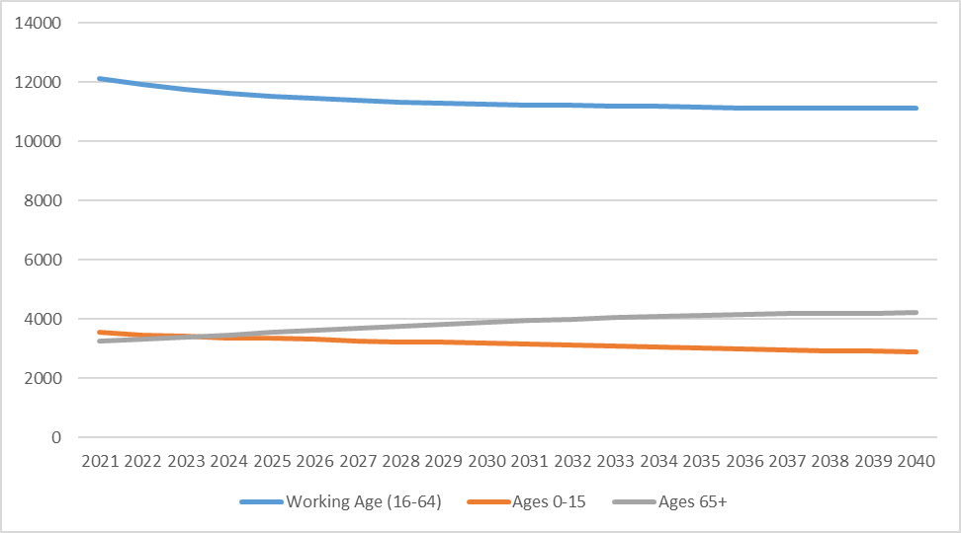
Figure 7: Population by Region by Age Cohort (New York City)
Category 3

Slide 21
Q&A
Thank you for attending!
For more information, please contact info@remi.com

