Slide 1

Using Socio-Economic Indicators in Regional Economic Modeling
Regional Economic Models, Inc.

Slide 2
Agenda
Introduction
Compensation Distribution
Inequality Coefficient
Employment by Race and Gender
Employment by Educational Attainment
Prices by Income Level
Model Simulation
Q&A

Slide 3
Introduction
Analysts use regional macroeconomic models to answer “what if?...” questions about the effects of policies on national, state, local, and other regional economies.
Typically, decision-makers and the public have been most interested in aggregate indicators (total employment, GDP, personal income) in assessing policies.
Increasingly, policy makers would like to understand the effects of policies on the distribution of wages/income, on racial/ethnic groups, on male/female workers, and on employment by educational attainment.
This paper presents REMI SEI, showing the distributional effects of regional economic policies.
In particular, REMI SEI addresses the need for public policy to provide broad-based benefits to the residents of a region.
Notes:
Lockout slide

Slide 4









Measurements of Disparities in REMI-SEI
Compensation Distribution
Employment Changes by Earnings Quintile
Consumption Price by Earnings Quintile and Range
Inequality Coefficient
Employment by
Race & Gender
Employment by Educational Attainment
Labor Force Participation
by Race & Gender
Unemployment
Per Capita
Income

Slide 5
Agenda
Introduction
Compensation Distribution
Inequality Coefficient
Employment by Race and Gender
Employment by Educational Attainment
Prices by Income Level
Model Simulation
Q&A

Slide 6
Compensation Distribution
Used regionally calculated industry quintiles​​
  Sorted industries using the ‘All Regions’ compensation rate, and divided into 5 groups with approximately the same number of sectors
Calculated a weighted average for each industry’s average annual compensation rate​​
Used each industry’s share of total employment in the baseline as the weight​
Policy change
REMI models
Industrial employment
&
Industrial compensation
Industrial compensation rate
Weighted Compensation Rate
Notes:
For each quintile, the result is calculated as a weighted average of each member industry's average annual compensation rate, where each weight is the industry's share of total employment in the baseline forecast.

Slide 7
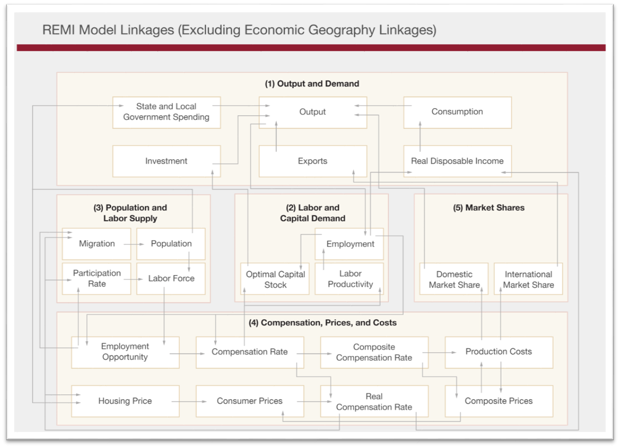
REMI Model Linkages

Slide 8
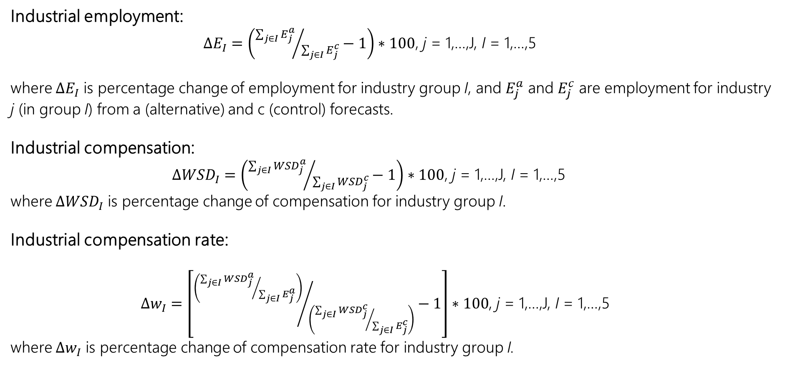
Compensation Distribution
Industrial employment:
$ΔE_{I}=\left({\sum_{j∈I}{E_{j}^{a}}}/{\sum_{j∈I}{E_{j}^{c}}}−1\right)∗100$, j = 1,…,J, I = 1,…,5
where $ΔE_{I}$ is percentage change of employment for industry group I, and $E_{j}^{a}$ and $E_{j}^{c}$ are employment for industry j (in group I) from a (alternative) and c (control) forecasts.
Industrial compensation:
$Δ{WSD}_{I}=\left({\sum_{j∈I}{{WSD}_{j}^{a}}}/{\sum_{j∈I}{{WSD}_{j}^{c}}}−1\right)∗100$, j = 1,…,J, I = 1,…,5
where $Δ{WSD}_{I}$ is percentage change of compensation for industry group I.
Industrial compensation rate:
$Δw_{I}=\left[{\left({\sum_{j∈I}{{WSD}_{j}^{a}}}/{\sum_{j∈I}{E_{j}^{a}}}\right)}/{\left({\sum_{j∈I}{{WSD}_{j}^{c}}}/{\sum_{j∈I}{E_{j}^{c}}}\right)}−1\right]∗100$, j = 1,…,J, I = 1,…,5
where $Δw_{I}$ is percentage change of compensation rate for industry group I.

Slide 9
Agenda
Introduction
Compensation Distribution
Inequality Coefficient
Employment by Race and Gender
Employment by Educational Attainment
Prices by Income Level
Model Simulation
Q&A

Slide 10
Inequality Coefficient
The SEI module’s compensation Inequality Coefficient result is a measure of inequality in the distribution of industry-average compensation rates across jobs.
The coefficient is calculated by applying the Gini methodology to REMI’s employment by industry and average annual compensation rate by industry data.
Policy change
REMI models
Industrial employment
&
Average annual compensation rate by industry
Inequality Coefficient
Gini methodology
Notes:
For each quintile, the result is calculated as a weighted average of each member industry's average annual compensation rate, where each weight is the industry's share of total employment in the baseline forecast.

Slide 11
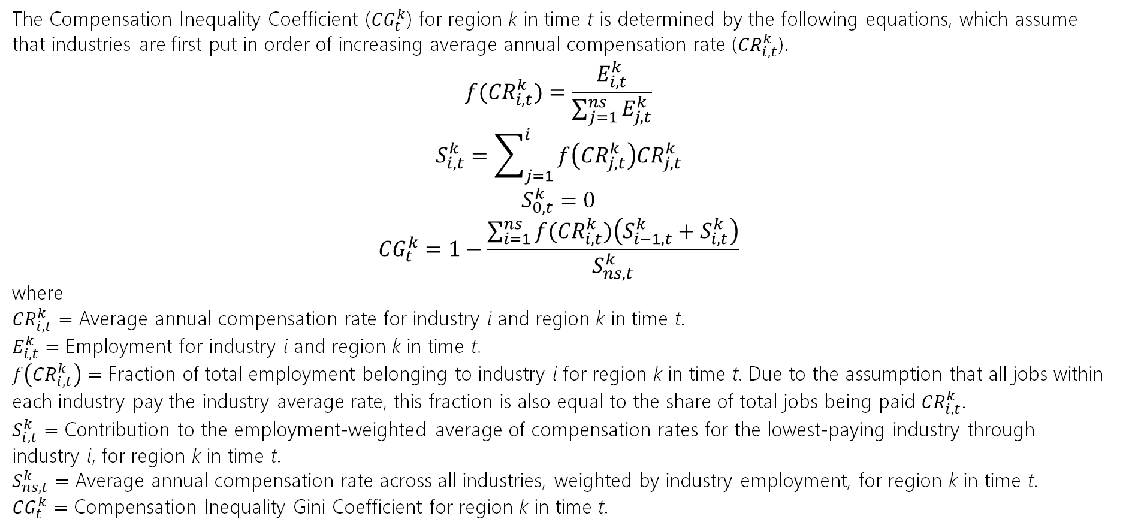
Inequality Coefficient
The Compensation Inequality Coefficient (${CG}_{t}^{k}$) for region k in time t is determined by the following equations, which assume that industries are first put in order of increasing average annual compensation rate (${CR}_{i,t}^{k}$).
$$f({CR}_{i,t}^{k})=\frac{E_{i,t}^{k}}{\sum_{j=1}^{ns}{E_{j,t}^{k}}}$$
$$S_{i,t}^{k}=\sum_{j=1}^{i}{f\left({CR}_{j,t}^{k}\right){CR}_{j,t}^{k}}$$
$$S_{0,t}^{k}=0$$
$${CG}_{t}^{k}=1−\frac{\sum_{i=1}^{ns}{f({CR}_{i,t}^{k})\left(S_{i−1,t}^{k}+S_{i,t}^{k}\right)}}{S_{ns,t}^{k}}$$
where
${CR}_{i,t}^{k}=$ Average annual compensation rate for industry i and region k in time t.
$E_{i,t}^{k}=$ Employment for industry i and region k in time t.
$f\left({CR}_{i,t}^{k}\right)=$ Fraction of total employment belonging to industry i for region k in time t. Due to the assumption that all jobs within each industry pay the industry average rate, this fraction is also equal to the share of total jobs being paid ${CR}_{i,t}^{k}$.
$S_{i,t}^{k}=$ Contribution to the employment-weighted average of compensation rates for the lowest-paying industry through industry i, for region k in time t.
$S_{ns,t}^{k}=$ Average annual compensation rate across all industries, weighted by industry employment, for region k in time t.
${CG}_{t}^{k}=$ Compensation Inequality Gini Coefficient for region k in time t.

Slide 12
Agenda
Introduction
Compensation Distribution
Inequality Coefficient
Employment by Race and Gender
Employment by Educational Attainment
Prices by Income Level
Model Simulation
Q&A

Slide 13
Employment by Race and Gender
Calculated national shares by race and gender for each occupation using ACS data​
​​Calculated national occupation weights for each race, gender, and occupation
Applied the national rates to the regions
  Took the national employment rates by race and gender
  Multiplied them by the labor force shares by race and gender
  Scaled up to 100%
ACS
Employment by race and gender shares for each occupation
National Occupation Weights
(Apply to all regions)
REMI Model
National Labor Force by Race and Gender
Notes:
First, a weighted average of 5-Year (2015-2019) sample with 2019 as the latest year is calculated using ACS as the external data source. This dataset provides national-level “employment by race and gender shares for each occupation” across REMI’s 95 occupations. Dividing the national ACS data by “REMI National Labor Force by Race and Gender” data, an “Occupation Weights” dataset is produced to feed into model building. The “Occupation Weights” dataset describes how national employment represents national labor force for each occupation. It captures the occupational effects in employment demographic distributions.
National occupation weights are applied to all regions. (When we apply the national rates to the regions, we take the national employment rates by race and gender and multiply them by the labor force shares by race and gender, then scale up to 100% to make sure that we don’t end up with more employment than exists for some race or gender groups.)
Although ACS data has both state- and county-level data, this procedure only uses the national level because there are many missing values in state- and county-level data, making it difficult to estimate missing values and ensure data quality at the same time. Using national level data can help minimize sampling errors. Additionally, there is no apparent historical or theoretical reason that explains regional difference in employment by race and gender shares for each occupation. In the forecast years, we assume occupation weights will not change significantly as there will not be drastic demographic distribution changes for each occupation.

Slide 14
Employment by Race and Gender
Estimated labor force demographic shares by place of work​​​
Converted commuter data from number of jobs to number of laborers​
Calculated commuter inflows and outflows by race and gender​
​Calculated labor force by place of work​​​
County-level “Commuter Income Flows”
& “Earnings by Place of Residence”
& county “Labor Force”
Labor commuters inflows and outflows
Adjusted “Labor Force by Place of Work”
REMI Model
Labor Force by Place of Residence
Notes:
Using county-level “Commuter Income Flows,” “Earnings by Place of Residence,” and county “Labor Force,” an estimation of the labor commuters (unit = individuals) inflows and outflows for a certain county are produced. This procedure assumes that commuters have the same demographic distribution as laborers in their place of residence. The adjusted “Labor Force by Place of Work” will be equal to “Labor Force by Place of Residence,” plus commuter inflows and minus commuter outflows.
The REMI labor force measurement “by place of residence” is converted to “by place of work,” to be consistent with the measurement of Employment. Using county-level “Commuter Income Flows,” “Earnings by Place of Residence,” and county “Labor Force,” an estimation of the labor commuters (unit = individuals) inflows and outflows for a certain county are produced. This procedure assumes that commuters have the same demographic distribution as laborers in their place of residence. The adjusted “Labor Force by Place of Work” will be equal to “Labor Force by Place of Residence,” plus commuter inflows and minus commuter outflows.
In history years, the labor force demographic shares of the origin regions are used to distribute commuter inflows. In forecast years, since we do not have the labor force demographic shares forecasts for regions outside of the model region, we estimate these shares based on last history year data, which gives a relatively accurate demographic distribution of commuter inflows. Then, national labor force demographic distribution forecasts are used to adjust “last history year commuter inflows by race and gender.”

Slide 15
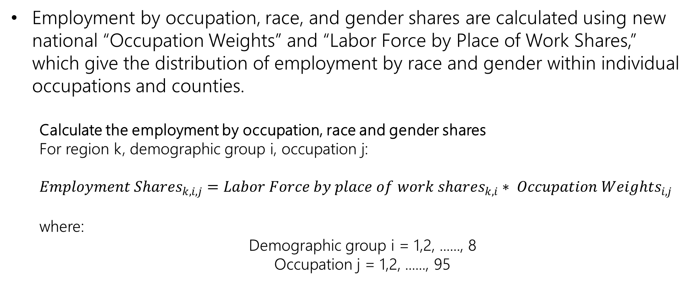
Employment by Race and Gender
Employment by occupation, race, and gender shares are calculated using new national “Occupation Weights” and “Labor Force by Place of Work Shares,” which give the distribution of employment by race and gender within individual occupations and counties.
  Calculate the employment by occupation, race and gender shares
  For region k, demographic group i, occupation j:
  $${Employment Shares}_{k,i,j}={Labor Force by place of work shares}_{k,i}∗ {Occupation Weights}_{i,j}$$
  where:
  Demographic group i = 1,2, ......, 8
  Occupation j = 1,2, ......, 95
Notes:
Using county-level “Commuter Income Flows,” “Earnings by Place of Residence,” and county “Labor Force,” an estimation of the labor commuters (unit = individuals) inflows and outflows for a certain county are produced. This procedure assumes that commuters have the same demographic distribution as laborers in their place of residence. The adjusted “Labor Force by Place of Work” will be equal to “Labor Force by Place of Residence,” plus commuter inflows and minus commuter outflows.
The REMI labor force measurement “by place of residence” is converted to “by place of work,” to be consistent with the measurement of Employment. Using county-level “Commuter Income Flows,” “Earnings by Place of Residence,” and county “Labor Force,” an estimation of the labor commuters (unit = individuals) inflows and outflows for a certain county are produced. This procedure assumes that commuters have the same demographic distribution as laborers in their place of residence. The adjusted “Labor Force by Place of Work” will be equal to “Labor Force by Place of Residence,” plus commuter inflows and minus commuter outflows.
In history years, the labor force demographic shares of the origin regions are used to distribute commuter inflows. In forecast years, since we do not have the labor force demographic shares forecasts for regions outside of the model region, we estimate these shares based on last history year data, which gives a relatively accurate demographic distribution of commuter inflows. Then, national labor force demographic distribution forecasts are used to adjust “last history year commuter inflows by race and gender.”

Slide 16
Agenda
Introduction
Compensation Distribution
Inequality Coefficient
Employment by Race and Gender
Employment by Educational Attainment
Prices by Income Level
Model Simulation
Q&A

Slide 17
Employment by Educational Attainment
Calculated number of new jobs created that do not require college education by multiplying employment by occupation by percentage of educational attainment by occupation, from BLS data​​
Aggregated educational levels to create summary of occupations by “Bachelor’s degree and above” and “no Bachelor’s degree”​
Policy change
REMI Model
Employment by Occupation
Employment by educational attainment
&
Percentage of educational attainment by Occupation
Notes:
First, a weighted average of 5-Year (2015-2019) sample with 2019 as the latest year is calculated using ACS as the external data source. This dataset provides national-level “employment by race and gender shares for each occupation” across REMI’s 95 occupations. Dividing the national ACS data by “REMI National Labor Force by Race and Gender” data, an “Occupation Weights” dataset is produced to feed into model building. The “Occupation Weights” dataset describes how national employment represents national labor force for each occupation. It captures the occupational effects in employment demographic distributions.
National occupation weights are applied to all regions. Although ACS data has both state- and county-level data, this procedure only uses the national level because there are many missing values in state- and county-level data, making it difficult to estimate missing values and ensure data quality at the same time. Using national level data can help minimize sampling errors. Additionally, there is no apparent historical or theoretical reason that explains regional difference in employment by race and gender shares for each occupation. In the forecast years, we assume occupation weights will not change significantly as there will not be drastic demographic distribution changes for each occupation.

Slide 18
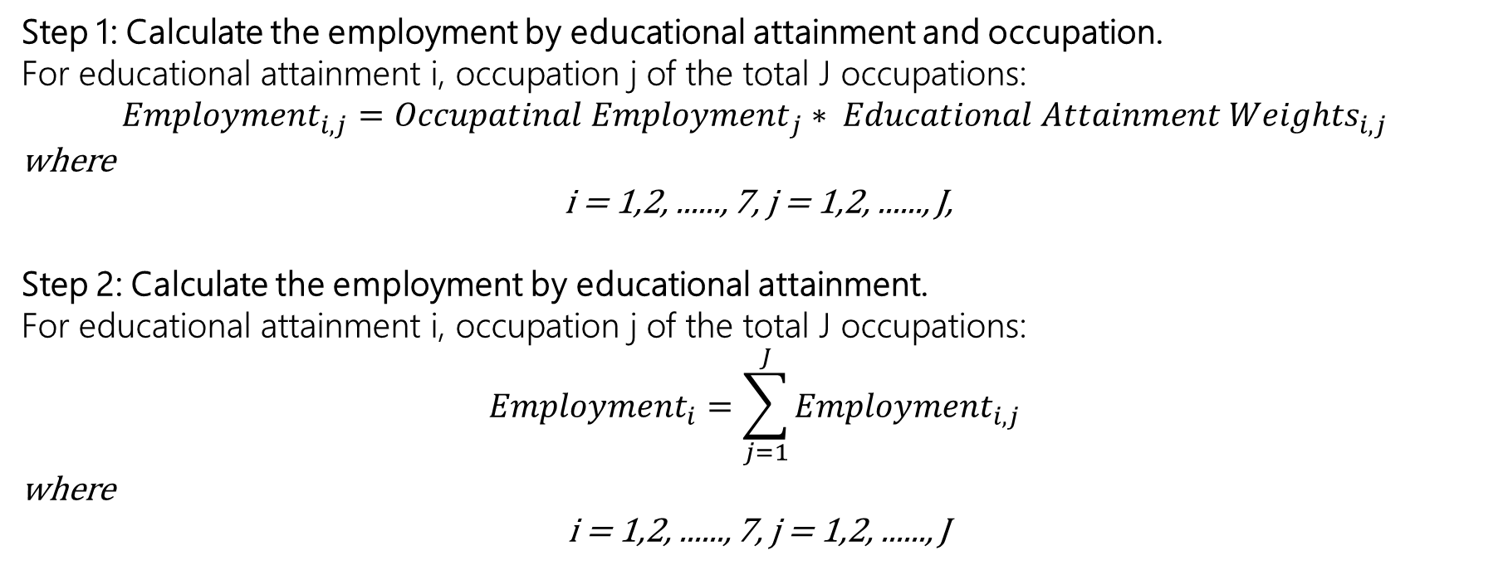
Employment by Educational Attainment
Step 1: Calculate the employment by educational attainment and occupation.
For educational attainment i, occupation j of the total J occupations:
$${Employment}_{i,j}={Occupatinal Employment}_{j}∗ {Educational Attainment Weights}_{i,j}$$
where
i = 1,2, ......, 7, j = 1,2, ......, J,
Step 2: Calculate the employment by educational attainment.
For educational attainment i, occupation j of the total J occupations:
$${Employment}_{i}=\sum_{j=1}^{J}{{Employment}_{i,j}}$$
where
i = 1,2, ......, 7, j = 1,2, ......, J
Notes:
Using county-level “Commuter Income Flows,” “Earnings by Place of Residence,” and county “Labor Force,” an estimation of the labor commuters (unit = individuals) inflows and outflows for a certain county are produced. This procedure assumes that commuters have the same demographic distribution as laborers in their place of residence. The adjusted “Labor Force by Place of Work” will be equal to “Labor Force by Place of Residence,” plus commuter inflows and minus commuter outflows.
The REMI labor force measurement “by place of residence” is converted to “by place of work,” to be consistent with the measurement of Employment. Using county-level “Commuter Income Flows,” “Earnings by Place of Residence,” and county “Labor Force,” an estimation of the labor commuters (unit = individuals) inflows and outflows for a certain county are produced. This procedure assumes that commuters have the same demographic distribution as laborers in their place of residence. The adjusted “Labor Force by Place of Work” will be equal to “Labor Force by Place of Residence,” plus commuter inflows and minus commuter outflows.
In history years, the labor force demographic shares of the origin regions are used to distribute commuter inflows. In forecast years, since we do not have the labor force demographic shares forecasts for regions outside of the model region, we estimate these shares based on last history year data, which gives a relatively accurate demographic distribution of commuter inflows. Then, national labor force demographic distribution forecasts are used to adjust “last history year commuter inflows by race and gender.”

Slide 19
Agenda
Introduction
Compensation Distribution
Inequality Coefficient
Employment by Race and Gender
Employment by Educational Attainment
Prices by Income Level
Model Simulation
Q&A

Slide 20
Prices by Income Level
Calculated as the weighted average of Consumption Commodity Prices for each income group (either quintiles or eight income ranges).
The weights for each commodity price are based on each group's national average share of spending devoted to that commodity category.
Spending data by income group come from the BLS Consumer Expenditure Survey.
BLS Consumer Expenditure Survey
Weights for each commodity price
Prices by Income Level
&
REMI Model
Consumption Commodity Prices for each income group
Notes:
For each quintile, the result is calculated as a weighted average of each member industry's average annual compensation rate, where each weight is the industry's share of total employment in the baseline forecast.

Slide 21
Agenda
Introduction
Compensation Distribution
Inequality Coefficient
Employment by Race and Gender
Employment by Educational Attainment
Prices by Income Level
Model Simulation
Q&A

Slide 22
Model Simulation: Set Up
Model
Two-region, 70-sector PI+ model
Regions are center cites and the rest of U.S.
Scenario
Decrease amenity by 5% in the center cities
Make no change to amenities in the rest of U.S.
Years
2020 through 2040
Amenity decrease implemented each year

Slide 23
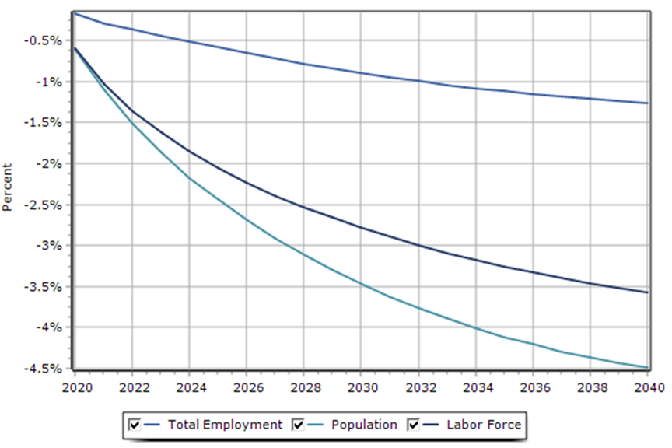
Model Simulation: REMI SEI
Economic Summary – Center Cities

Slide 24
Model Simulation: REMI SEI
Components of Population Change – Center Cities

Slide 25
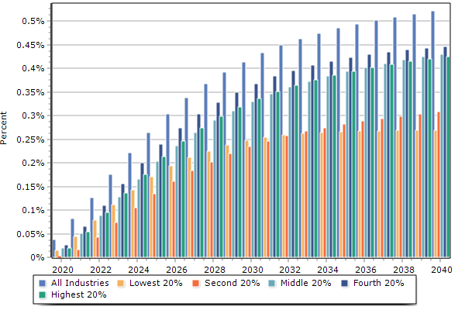
Model Simulation: REMI SEI
Compensation Rate by Industry Quintile – Center Cities
Workers in center cities need to be paid higher wages to keep them in cities with declining amenity factors. The labor supply is also reduced over time. Workers in the rest of the U.S. are paid less and experience a more competitive labor market.

Slide 26
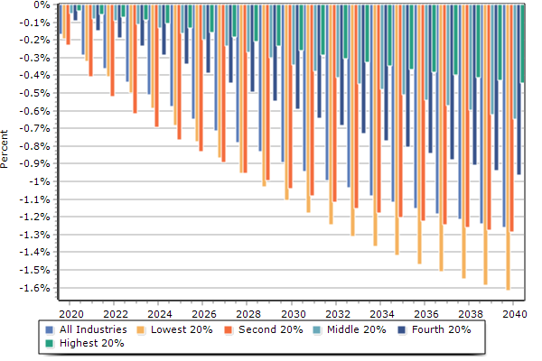
Model Simulation: REMI SEI
Employment by Industry Quintile – Center Cities

Slide 27
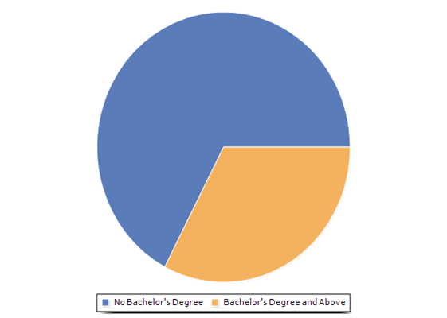
Model Simulation: REMI SEI
Employment by Education – Center Cities (Summary)
Year 2040
Approximately a third of the U.S. population has a bachelor’s degree and above. These job losses in center cities are proportional to the national metric.
However, jobs requiring bachelor’s degrees are more “footloose,” so the loss of this kind of job is more conducive to finding another similar job elsewhere. Workers without bachelor’s degrees face more challenges in center cities finding comparable jobs.
-370
-180

Slide 28
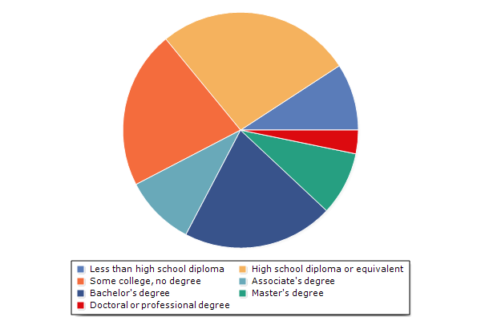
Model Simulation: REMI SEI
Less than high school diploma | High school diploma or equivalent | Some college, no degree | Associate's degree | Bachelor's degree | Master's degree | Doctoral or professional degree
-50.602 | -147.448 | -119.366 | -53.420 | -114.081 | -48.150 | -17.780
Employment by Education – Center Cities (Detail)
Year 2040

Slide 29
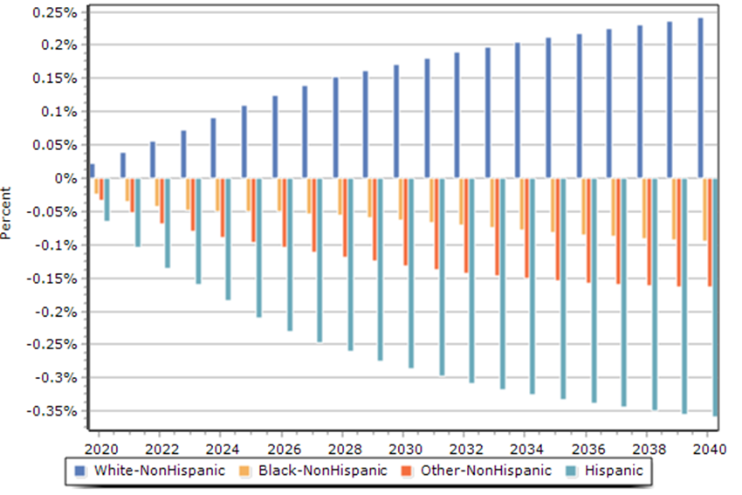
Model Simulation: REMI SEI
Employment by Race – All Regions
COVID migration trends affect SEI across the entire nation, not just within center cities, through the widening of racial/ethnic disparities.

Slide 30
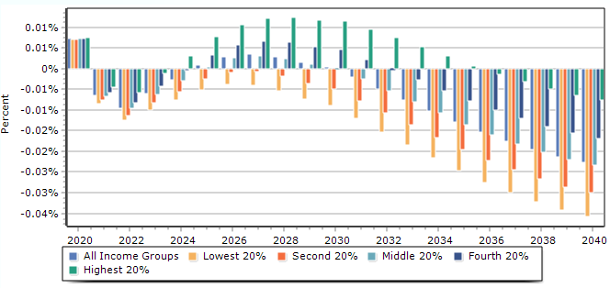
Model Simulation: REMI SEI
Prices by Income Level – All Regions

Slide 31
Conclusion
REMI-SEI shows the distributional effects of regional economic policies
Public policies are meant to benefit the public; analysis of the effect of policies for compensation, educational and demographic groups helps policy-makers evaluate policy implications for all residents
Racial, gender, regional, and educational disparities are driving the political and policy agenda at the national, state and local level
REMI-SEI allows these questions to be addressed in a constructive, data-based framework.
Notes:
Using county-level “Commuter Income Flows,” “Earnings by Place of Residence,” and county “Labor Force,” an estimation of the labor commuters (unit = individuals) inflows and outflows for a certain county are produced. This procedure assumes that commuters have the same demographic distribution as laborers in their place of residence. The adjusted “Labor Force by Place of Work” will be equal to “Labor Force by Place of Residence,” plus commuter inflows and minus commuter outflows.
The REMI labor force measurement “by place of residence” is converted to “by place of work,” to be consistent with the measurement of Employment. Using county-level “Commuter Income Flows,” “Earnings by Place of Residence,” and county “Labor Force,” an estimation of the labor commuters (unit = individuals) inflows and outflows for a certain county are produced. This procedure assumes that commuters have the same demographic distribution as laborers in their place of residence. The adjusted “Labor Force by Place of Work” will be equal to “Labor Force by Place of Residence,” plus commuter inflows and minus commuter outflows.
In history years, the labor force demographic shares of the origin regions are used to distribute commuter inflows. In forecast years, since we do not have the labor force demographic shares forecasts for regions outside of the model region, we estimate these shares based on last history year data, which gives a relatively accurate demographic distribution of commuter inflows. Then, national labor force demographic distribution forecasts are used to adjust “last history year commuter inflows by race and gender.”

Slide 32
Agenda
Introduction
Compensation Distribution
Inequality Coefficient
Employment by Race and Gender
Employment by Educational Attainment
Prices by Income Level
Model Simulation
Q&A

Slide 33
Q&A
Thank you for attending!
For more information, please contact info@remi.com

